Slide 1

Amazon Web Services
workshop
for System Engineer
Introduction to Amazon Web Services

Slide 2
Topics
Overview of Amazon Web Services
AWS Products and Services
Migrating & AWS Pricing
AWS Partner Program & Resources

Slide 3
Objectives
You will be able to
Describe AWS cloud computing platform & AWS global infrastructure.
Describe traditional scalable web hosting & the challenges.
Identify characteristics that make the AWS cloud computing platform unique.

Slide 4
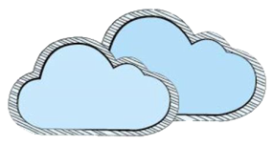
What is Cloud Computing?
The on-demand delivery of IT resources via Internet with pat-as-you-go pricing. Consume shared computing and storage resources rather than building, operating, and improving infrastructure on your own.

Slide 5
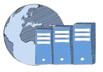





Amazon Web Services and Cloud Computing
AWS is a collection of remote computing services make up a cloud computing platform, offered via internet.
Compute
Storage
Storage
Database
Application Services
Management

Slide 6
On-Premise vs. Public Cloud
 | On-Premise | Public Cloud
 | Pay for resources regardless of whether you utilize them. | Pay only for what you use.
 | Large purchases on 1 year, 3 year, 5 year circles. | Not upfront investment. Pay monthly for variable usage.
 | Administration, patching, and daily tasks required to keep maintained. | IT has the time to innovate on new projects
 | Static Capacity. | Flexible Capacity.
 | Takes weeks or months to get a server procures, delivered, and running. | Provision resources as you need them, within minutes.
 | Different to distribute resources and setup end points in various geographies. | Quickly deploy resources in locations around the globe, within minutes.

Slide 7
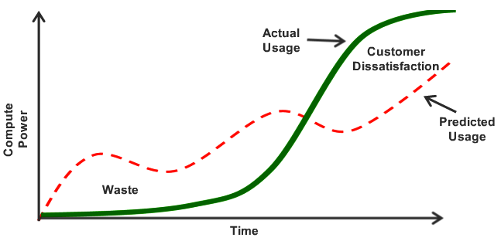
Flexible Capacity: Pay only for what you use

Slide 8

The AWS Platform
Deployment & Management
Analytics
Application Services
Compute
Storage
Database
Networking
AWS Global Infrastructure

Slide 9

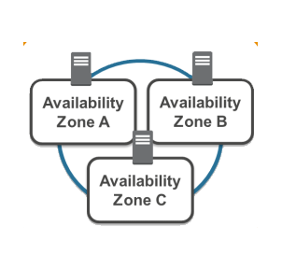
AWS: Global Infrastructure
Deployment & Management
Analytics
Application Services
Compute
Storage
Database
Networking
AWS Global Infrastructure
Region
Availability Zones
Edge Location

Slide 10
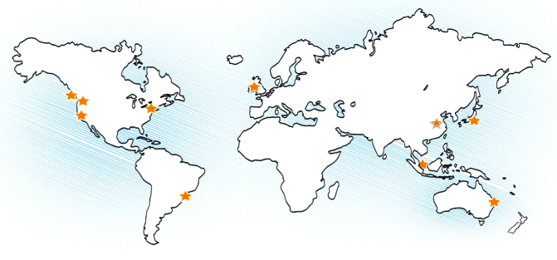
AWS Global Infrastructure: Region
AWS has 10 Regions, provides more than 190 countries, to help customers archive lower latency and higher throughput, and to ensure that their data resides only in the region they specify.
Ireland
Frankfurt
Oregon
Northern California
North
Virginia
Beijing*
Tokyo
Singapore
São Paulo
Sydney

Slide 11
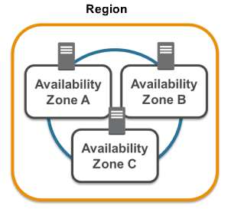
AWS Global Infrastructure: Availability Zones
A Region is a collection of two or more Availability Zones in a specific geographic region.
As are analogous to clusters of data center, kept isolated from each other. There is a single digit millisecond finer between AZs.
It is highly recommended to provision your resources across multiple AZs for added redundancy.

Slide 12
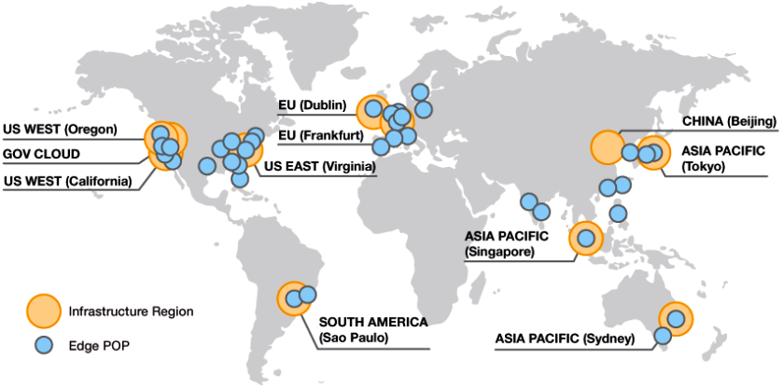
AWS Global Infrastructure:
Edge Locations
Hosts Amazon CloudFront, a CDN that can be used to deliver web sites and dynamic, static, and streaming content.
Requests for content are automatically routed to the nearest edge location, so content is delivered faster to customers.

Slide 13



AWS: Networking
Deployment & Management
Analytics
Application Services
Compute
Storage
Database
Networking
AWS Global Infrastructure
Route 53
Direct Connect
Virtual
Private Cloud

Slide 14






AWS: Compute
Deployment & Management
Analytics
Application Services
Compute
Storage
Database
Networking
AWS Global Infrastructure
EC2
Lambda
Auto Scaling
Load Balancer
WorkSpace

Slide 15

AWS: Storage
Deployment & Management
Analytics
Application Services
Compute
Storage
Database
Networking
AWS Global Infrastructure
S3
Glacier
EBS
Storage Gateway
Import/ Export

Slide 16



AWS: Database
Deployment & Management
Analytics
Application Services
Compute
Storage
Database
Networking
AWS Global Infrastructure
RDS
DynamoDB
ElastiCache

Slide 17




AWS: Analytics
Deployment & Management
Analytics
Application Services
Compute
Storage
Database
Networking
AWS Global Infrastructure
Kinesis
Elastic
Map/Reduce
Redshift
Notes:
Kinesis = real-time collecting & processing
RedShift = Data Warehouse

Slide 18


AWS: Application Services
Deployment & Management
Analytics
Application Services
Compute
Storage
Database
Networking
AWS Global Infrastructure
Cloud
Search
SWF
SQS
SNS
SES
Elastic
Transcoder

Slide 19


AWS: Application Services
Deployment & Management
Analytics
Application Services
Compute
Storage
Database
Networking
AWS Global Infrastructure
Elastic
Beanstalk
Cloud
Search
Data
Pipeline
IAMs
Cloud
Formation
OpWorks
CloudTrail
Notes:
Elastic Beanstalk = managed application container (Java, .net, PHP, node.js, Ruby, Python, Docker)

Slide 20
AWS Pricing Model
Free Tier :- The AWS Free Tier is designed to enable you to get hands-on experience with AWS at no charge for 12 months after you sign up.
Pay-as-you-go :- For certain services like Amazon EC2 and Amazon RDS, you can invest in reserved capacity. In that case, you pay a low upfront fee and get a significantly discounted hourly rate, which results in overall savings up to 60% (depending on the type of instance you reserve) over equivalent On-Demand capacity.
Pay less when you reserve :- For certain services like Amazon EC2 and Amazon RDS, you can invest in reserved capacity. In that case, you pay a low upfront fee and get a significantly discounted hourly rate, which results in overall savings up to 60% (depending on the type of instance you reserve) over equivalent On-Demand capacity.

Slide 21




















AWS Free Tier
The AWS Free Tier is designed to enable you to get hands-on experience with AWS at no charge for 12 months after you sign up.
After creating your AWS account you can use any of the 20 products and services, listed below, for free within certain usage limits.
EC2
S3
Lambda
AMI Key
Cognito
Appstream
Trusted
Advisor
DynamoDB
CloudFront
Data
Pipeline
RDS
Mobile
Analytics
EBS
ElastiCache
ELB
CloudWatch
SQS
SNS
SWF
SES
Goto http://aws.amazon.com/free/ for more information.
last update Jan 20, 2015

Slide 22
Amazon Partner Network (APN)
The AWS Partner Network (APN) is the global partner program for AWS. It is focused on helping partners build a successful AWS-based business by providing great business, technical, marketing, and GTM support.
APN Consulting Partners :- APN Consulting Partners are professional services firms that help customers design, architect, build, migrate, and manage their workloads and applications on AWS. Consulting Partners include System Integrators, Strategic Consultancies, Agencies, Managed Service Providers, and Value-Added Resellers.
APN Technology Partners :- APN Technology Partners provide software solutions that are either hosted on, or integrated with, the AWS platform. APN Technology Partners include Independent Software Vendors (ISVs), SaaS, PaaS, Developer Tools, Management and Security Vendors.
Goto http://aws.amazon.com/free/ for more information.

Slide 23
APN Partner Programs
APN Training Partner
AWS Channel Reseller
AWS China Region Partner
AWS Government Partner Program
AWS Managed Service Program
AWS Marketplace Seller
Mechanical Turk Partner

Slide 24
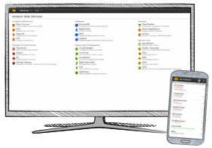
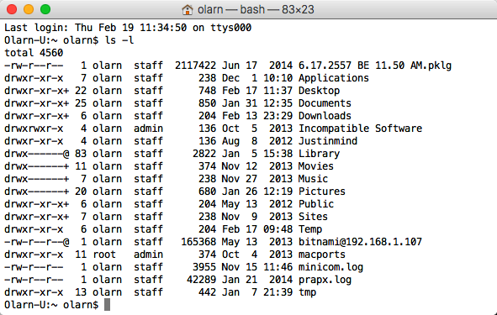
How to Interact with AWS
AWS Management Console A graphic user interface you access online at console.aws.amazon.com.
Mobile App A native iOS and Android app that can access many resources on AWS.
AWS Command Line Interface (CLI) The AWS CLI is for developers and those who are more comfortable typing in commands. It text-based tool you install on your computer and connects over the internet to manage your AWS resources. Several command-line tools are available: AWS CLI, custom CLIs for specific services, and Windows PowerShell tools for AWS.
Software Development Kits (SDKs) Class libraries and tools you add to your application so it can manage AWS resources. AWS offers SDKs in a varieties of programming and scripting language, as well as mobile SDKs for iOS and Android apps.
Query APIs Low-Level APIs that are exposed online through service- and region-specific endpoints. You call API actions by using HTTP requests. The APIs reflect the latest functionality of each service. If your application uses the API instead of an SDK, you must implement the functionality to generate the propose signatures to authenticate your requests.

Slide 25
Conclusion
AWS is a collection of remote computing services that make up a cloud computing platform, offered via the internet.
AWS has a large global infrastructure that customers can leverage to optimize performance or meet regulatory requirements.
AWS is different than traditional, on-premises solutions:
No upfront investment.
Low on going cost.
Apps not Ops.
Flexible capacity.
Pay only for what you use.
Speed and agility
Global reach.

Slide 26
Glossaries
AWS: Amazon Web Services
AZ: Availability Zone
VPC: Virtual Private Cloud
EC2: Elastic Compute Cloud
ELB: Elastic Load Balancer
S3: Simple Storage Service
EBS: Elastic Block Storage
RDS: Relational Database Service
SWF: Simple Work Flow Service
SQS: Simple Queue Service
EMR: Elastic MapReduces
SNS: Simple Notification Service
SES: Simple Email Service
AMI: Amazon Machine Image
IAM: Identity and Access Management

Slide 27
References & Resources
Amazon Web Services Homepage https://aws.amazon.com
AWS Training & Certification info http://aws.amazon.com/training/
qwikLABS https://qwiklabs.com
AWS Free Tier https://aws.amazon.com/free
Amazon Partner Network http://aws.amazon.com/partners/
AWS Total Cost of Ownership Calculator https://awstcocalculator.com
Simple Monthly Calculator http://calculator.s3.amazonaws.com/index.html

